Slide 1
SAVAC / LimVAC Outcome and Forecast Assessment
Limpopo Province
October 2015

Slide 2
Purpose of the Assessment
For SAVAC to assess the impact of the on-going drought in areas where baseline studies are complete
To demonstrate the effectiveness of the assessment framework with a view to rolling out further assessments in other provinces

Slide 3
SAVAC Framework for Assessment
After much deliberation the TRT and SAVAC agreed to combine two different types of information:
Cross-sectional survey analysis
“Food Security Continuum”
Longitudinal projections and forecast analysis
“Livelihoods-Based VA” “HEA”
Notes:
velihoods

Slide 4
Cross-sectional Assessment: The Food Security Continuum
Developed to answer the need for information that can accurately describe proportions of populations in different FS categories, recognising:
Need to identifiy any small groups of seriously hungry or deprived people
Existance of many types of ‘hidden hunger’
The fact even ‘food secure’ populations may be vulnerable to certain hazards

Slide 5
Cross-sectional Surveys Analysis: Food Security Continuum
Acute food insecurity | Chronic food insecurity | Hidden hunger |  |  | Vulnerable to becoming food insecure in the future | Food secure
 |  | Under- nourished | Adequate energy intake with micro-nutrient deficiencies | Obesity with poverty
Starvation | Food insecure |  |  |  | Food secure

Slide 6
Longitudinal Assessment: The Household Economy Approach
Developed to respond to a demand for an assessment approach that could:
Quantify the problem
Allow for comparisons
Provide reliable results for populations
Point to appropriate policy responses
Be predictive

Slide 7
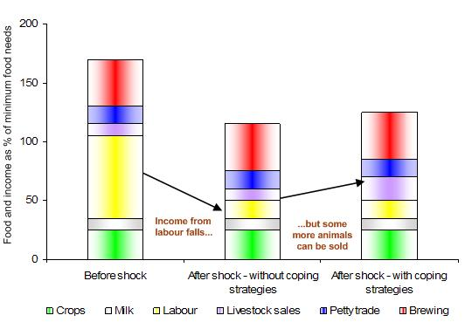
Longitudinal Framework
Focuses what people are vulnerable to and how they might be able to cope.
HEA analysis provides guidance on possible interventions by showing how households are affected by and respond to a hazard. This is essential for planning and decision-making
Livelihoods Protection Threshold
Survival Threshold
Gap
Notes:
I’ve changed the text on the gap and what it means

Slide 8
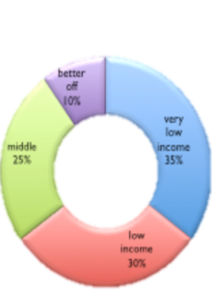
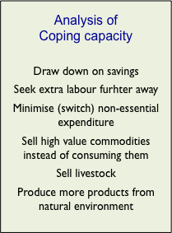
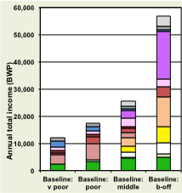
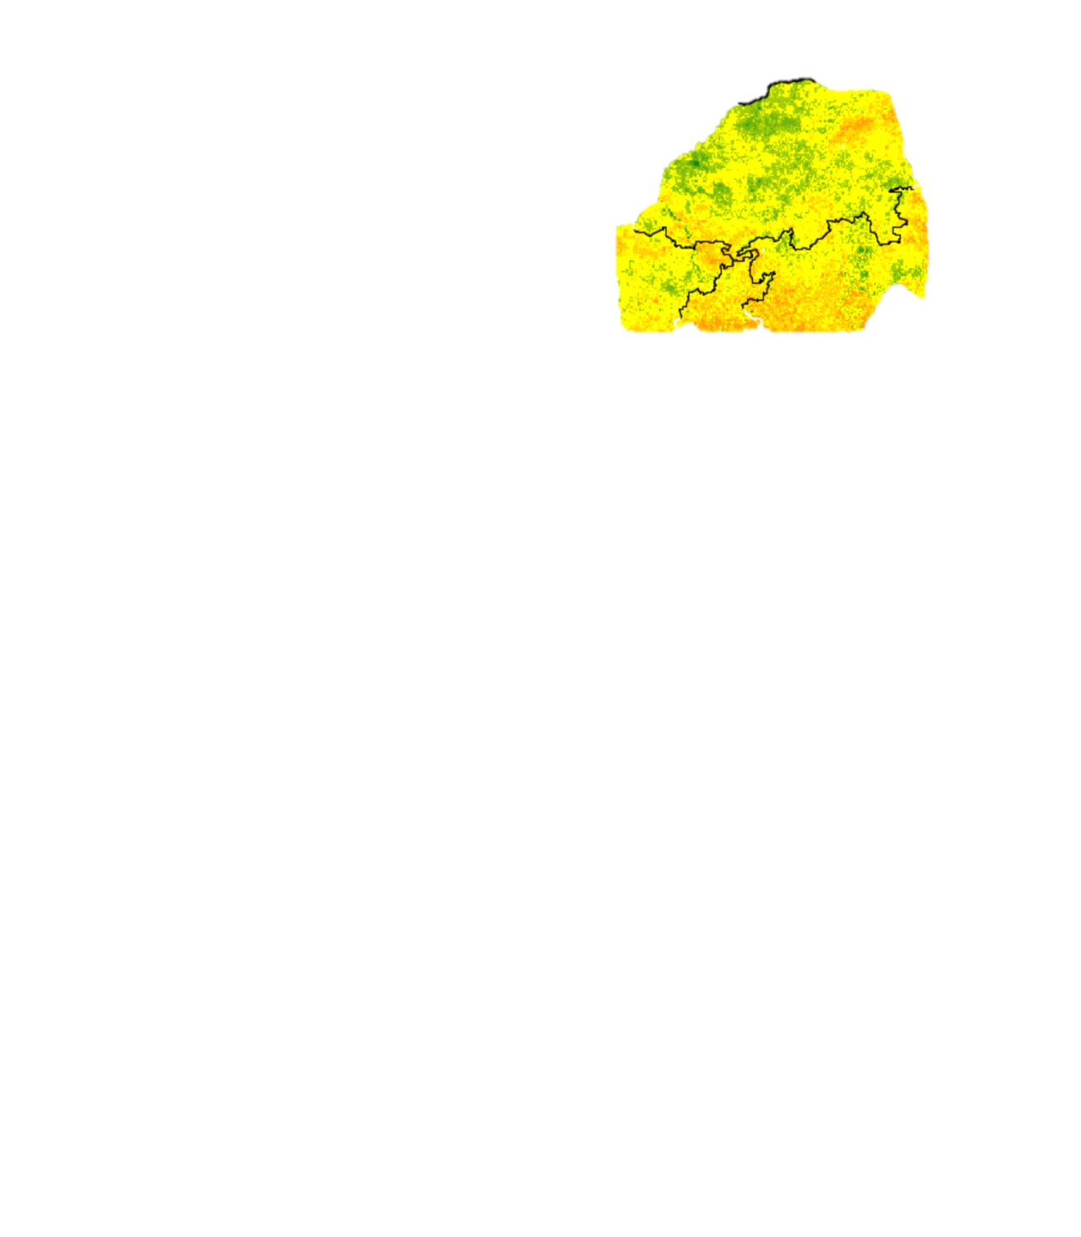
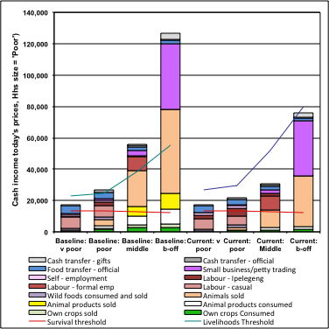
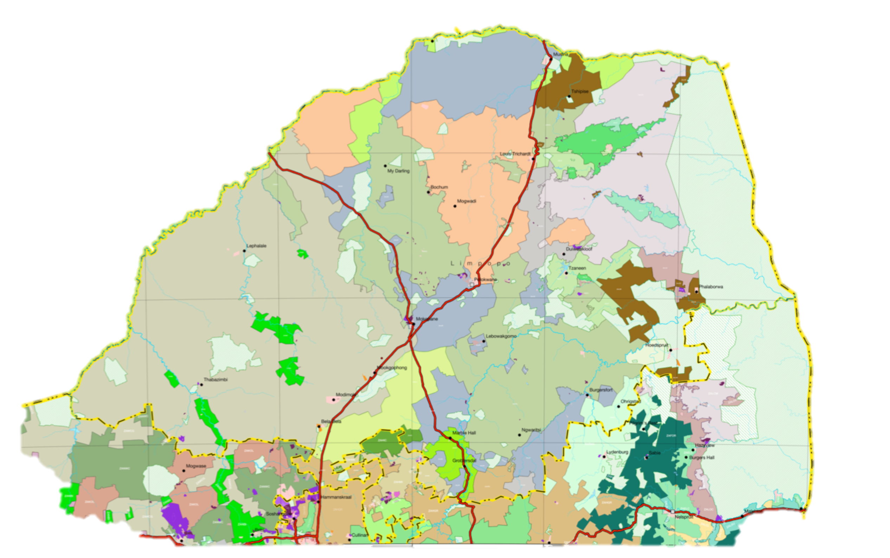
Longitudinal Framework Summary
In practice this process is broken into six (2 x 3) steps:
+
(x
=
(BASELINE
x
HAZARD)
(COPING
HAZARD))
OUTCOME
DRM Framework
Vulnerability
Hazard
1 / Capacity
Risk
Baseline
Outcome and Forecast Analysis
Step 1
Step 2
Step 3
Step 4
Step 5
Step 6
Livelihood Zones
WealthBreakdown
Livelihood Strategies
Problem Specification
Projected Outcome
Crop production 60%
Livestock price 40%
Notes:
I’ve added in the Light Green Overlay to highlight HEA’s connections with the standard DRM Framework (used by NDMC and DCoG) with its definitions of Risk, Vulnerability, Capacity and Hazard. In a sense, HEA operationalises the DRM framework because it makes a clear link between people’s Risk (the outcome), the Hazard and their Vulnerability to that particular hazard or set of hazards.

Slide 9
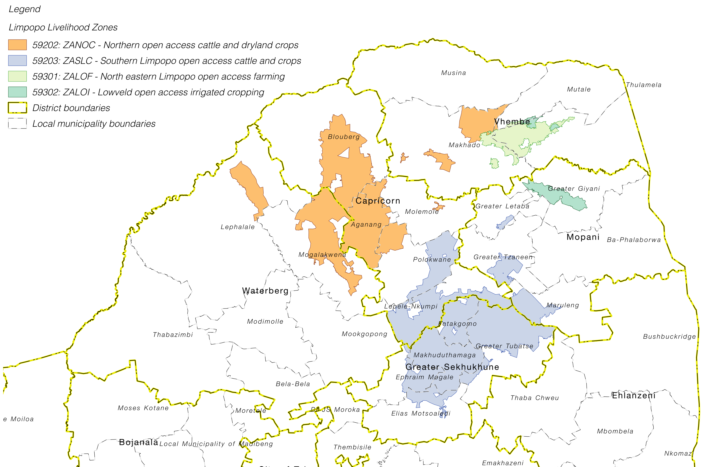
Baselines
Took place in February-March 2015
Four Livelihood Zones:
Continuum Survey
Household Economy
Projection: Albers Equal Area, SPs 23.77S & 24..88S

Slide 10
Previously Completed
Baselines shared with SAVAC in March 2015
Both Continuum and Livelihoods results were presented
Reports and Baselines Profiles

Slide 11
Forecasts
Important to understand the timing
A livelihoods baseline covers a period of a whole year – a Consumption Year
In a crop farming livelihood system, the Consumption Year runs from the beginning of the harvest until the next harvest
In all Limpopo LZs, this is usually from April to the following March

Slide 12
Forecasts
Forecasting is always a guess
The aim is to be as realistic as possible and to use as much known data as possible
Must be balanced against looking as far forward as possible
Usually, based on the Consumption Year
Make the forecast at the beginning of the Consumption Year
Use information from crop harvest, economic data and other known sources
Assumptions and scenarios for still-unknown variables

Slide 13
OFA Limpopo 2015
Covers period April 2015 to March 2016
Still forward looking
Was undertaken in October 2015, so many trends emerging – cementing the scenarios

Slide 14
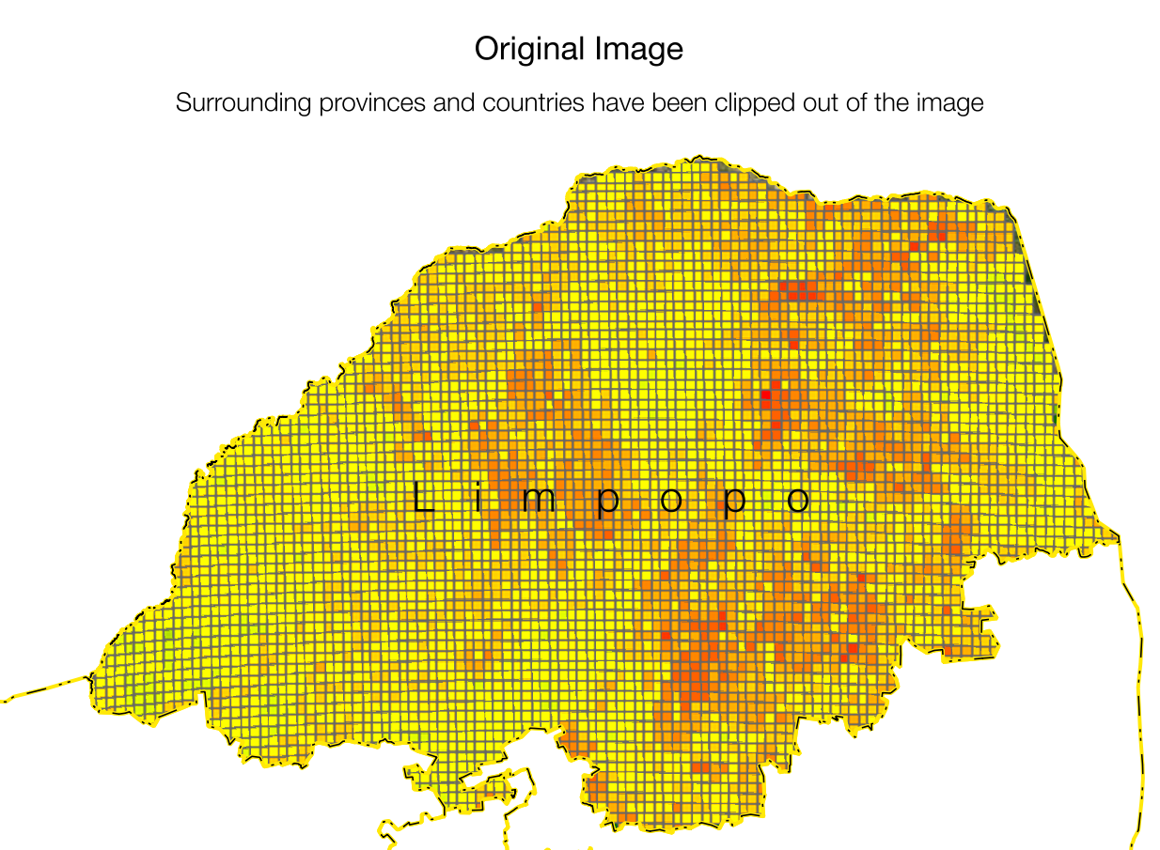
Hazard Definition

Slide 15
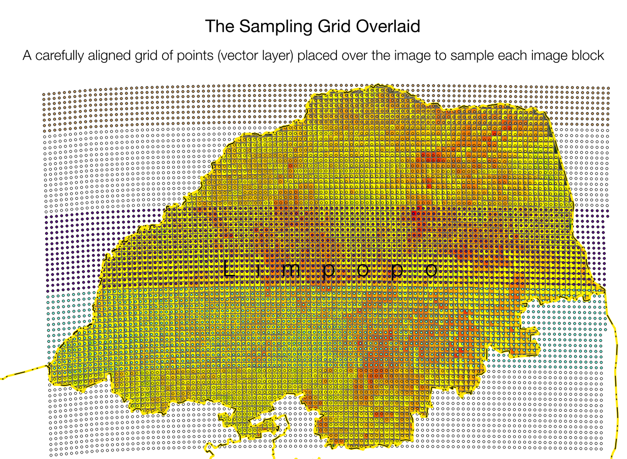
Hazard Definition

Slide 16
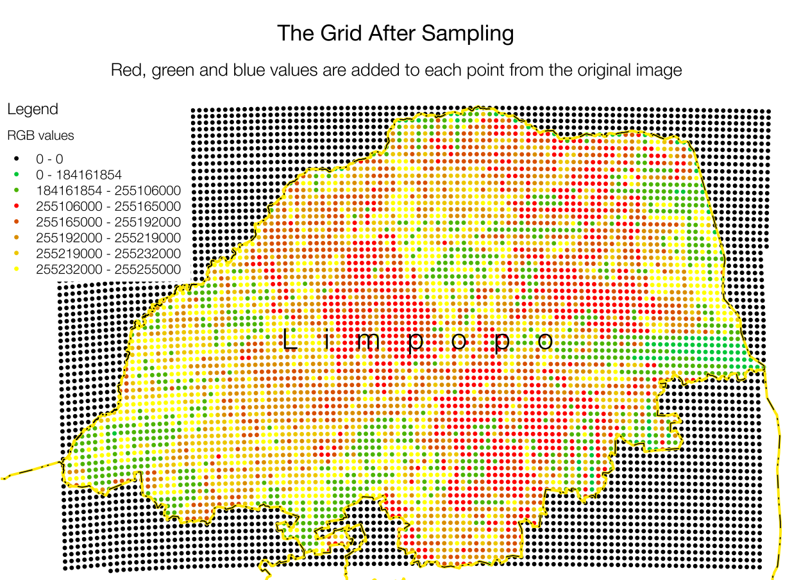
Hazard Definition

Slide 17
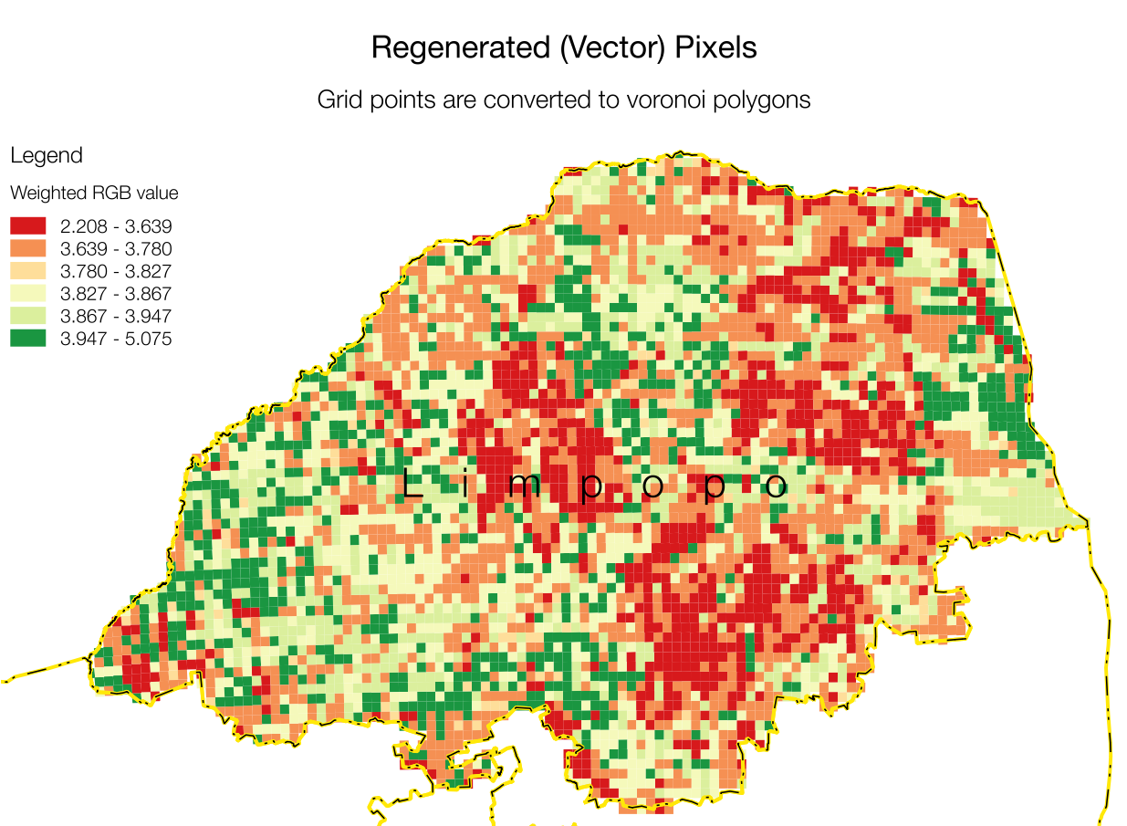
Hazard Definition

Slide 18
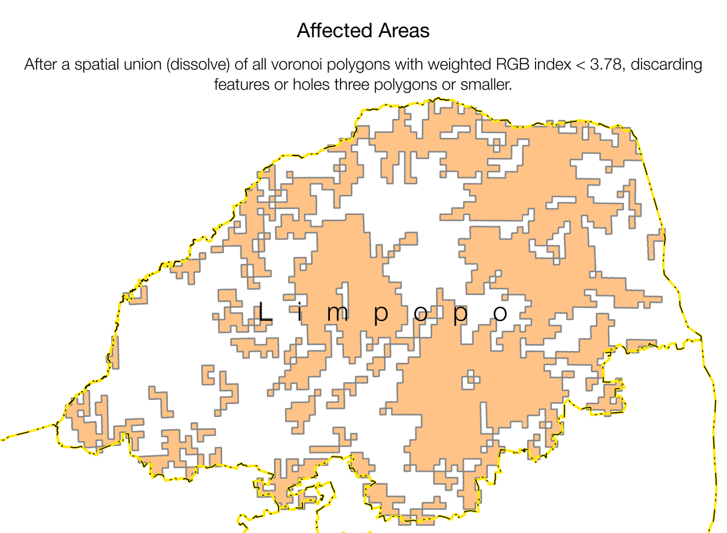
Hazard Definition

Slide 19
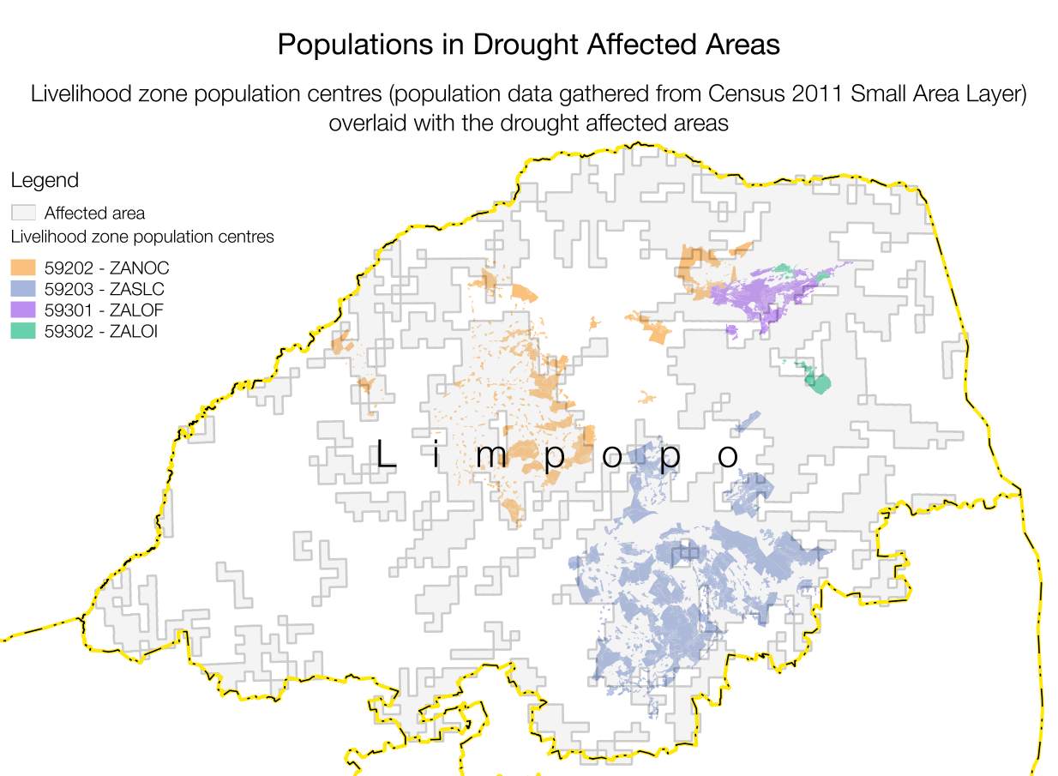
Hazard Definition

Slide 20
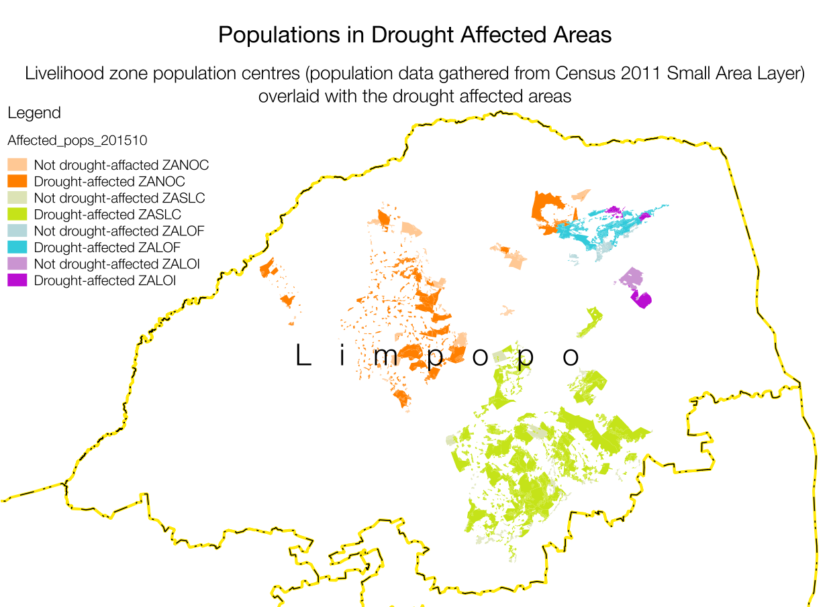
Hazard Definition

Slide 21
Problem Specifications (Hazard Definition)
Drought Affected
Less Drought Affected
Very bad crop production: 20% of Baseline (-80%)
Bad agric work opportunities: 30% to 60% of Baseline (-70% to -40%)
Other work normal
Livestock production affected by earlier sales and poor condition
Fairly normal crop production: 80% to 100% of normal (-20% to 0%)
Also bad agric work opportunities: 40% to 70% (-60% to -30%)
Other work normal
Livestock production not as severely affected

Slide 22
Common Problem Specifications
Purchase prices, e.g. Staple (+12%), other food (+11%) [Stats SA CPI]
Sales prices – usually +7% to +15% (depends on commodity [NAMC]
Access to social grants – no change
Social grant amounts (wage) – 7%

Slide 23
Outcomes Presentation
All production that is consumed directly monetised into “income”
This “Total Income” compared against three levels (based on Statistics SAs Income Expenditure Surveys):
Food Poverty Line
Lower Bound Poverty Line
Upper Bound poverty Line

Slide 24
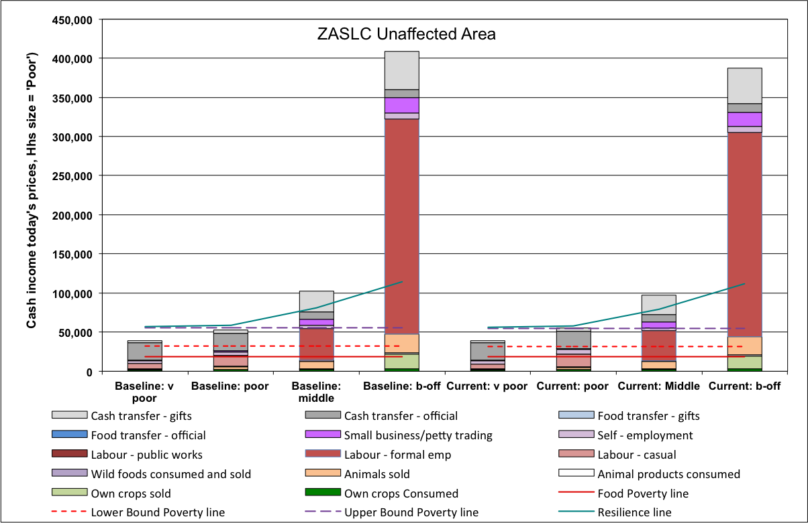
Analysis – Example of Affected vs Unaffected

Slide 25
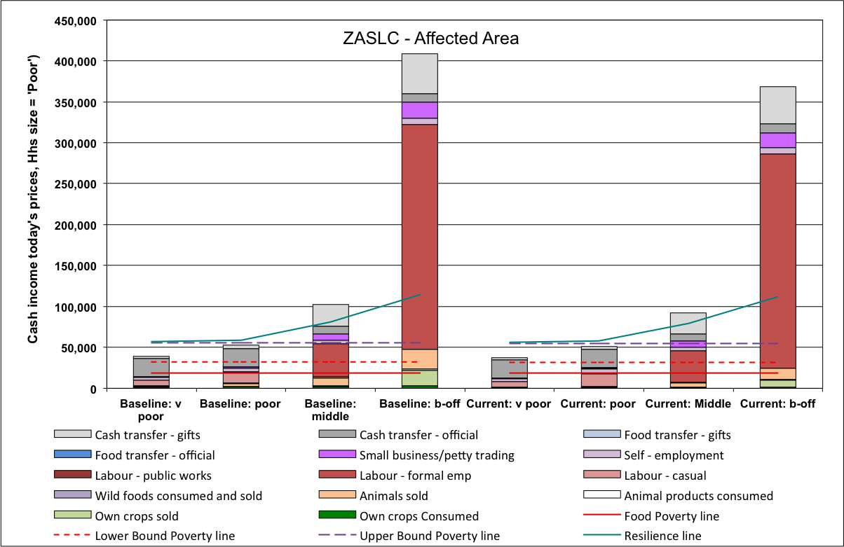
Analysis – Example of Affected vs Unaffected

Slide 26
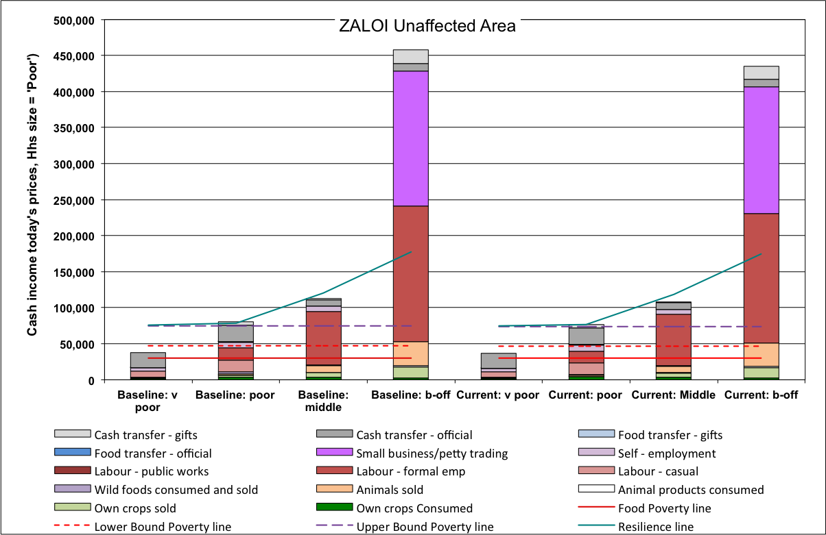
Analysis – Example of Affected vs Unaffected

Slide 27
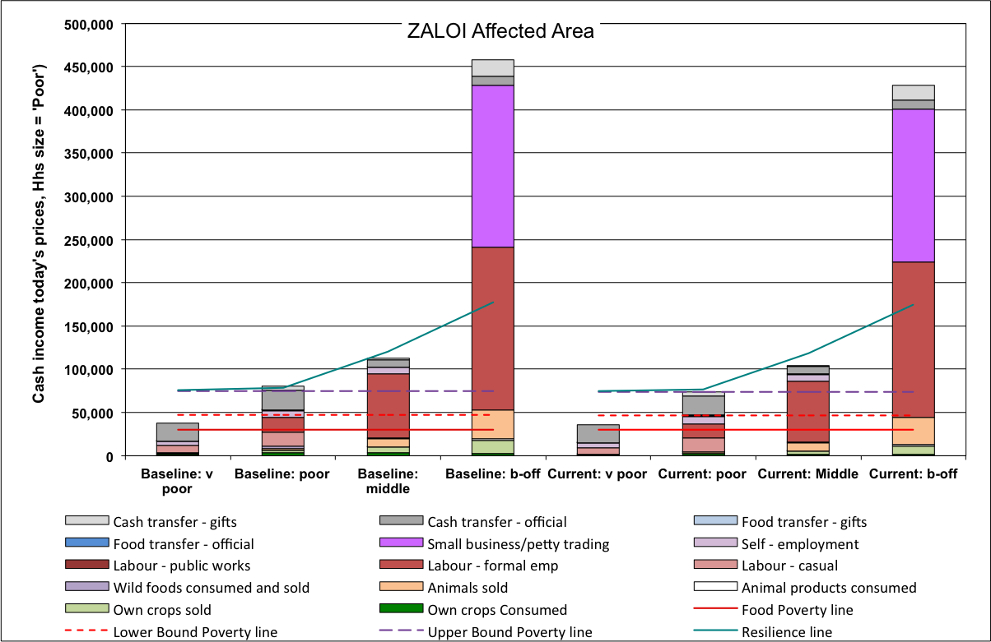
Analysis – Example of Affected vs Unaffected

Slide 28
Key driver: Food Purchase Prices
Scenarios for effect of price changes on deficits

Slide 29
What next?
Impact of possible rising prices on livelihoods dues to
Low commercial production in 2016
Weak Rand
Synthesise baselines for other rural areas?
Poverty nodes overlaid onto livelihood zones
Use NISIS, Income-Expend Surveys, LSS, etc.
Make and approximate projection for 2016-17
Follow up with more baselines surveys

